Slide 1
Keyloggers project
CAPSTONE PROJECT
Presented By:
K.Pragatheeswari,
Anjalai Ammal Mahalingam Engineering College,
Information Technology.

Slide 2
OUTLINE
Problem Statement (Should not include solution)
Proposed System/Solution
System Development Approach (Technology Used)
Algorithm & Deployment
Result (Output Image)
Conclusion
Future Scope
References

Slide 3
Problem Statement
In today's digital age, where cybersecurity threats loom large, one of the significant concerns is the proliferation of keyloggers, stealthy software tools designed to monitor and record keystrokes on a user's computer without their knowledge. Keyloggers pose a severe threat to individuals and organizations as they can capture sensitive information such as passwords, credit card details, and other personal data, leading to identity theft, financial loss, and privacy breaches.

Slide 4
Proposed Solution
The proposed system aims to enhance traditional keyloggers by adding encryption to the logged keystrokes. This ensures that even if the log files are intercepted, the data remains secure and cannot be easily accessed.
By using Python, a widely used and easy-to-understand programming language, the implementation of the secure keylogger becomes accessible to a wide range of users.

Slide 5
System Approach
The system utilizes the cryptography library in Python for encrypting the keystrokes. This library provides robust encryption algorithms such as AES (Advanced Encryption Standard) for securing the data.
The keyboard library is used for capturing keystrokes. This library allows the keylogger to run in the background and capture keystrokes without affecting the user's experience.

Slide 6
Algorithm & Deployment
The AES encryption algorithm is used to encrypt the keystrokes. AES is a symmetric key encryption algorithm that is widely used for its security and efficiency.
The keylogger can be deployed on various operating systems (Windows, macOS, Linux) by simply installing Python and the required libraries. This makes the keylogger highly versatile and accessible.

Slide 7
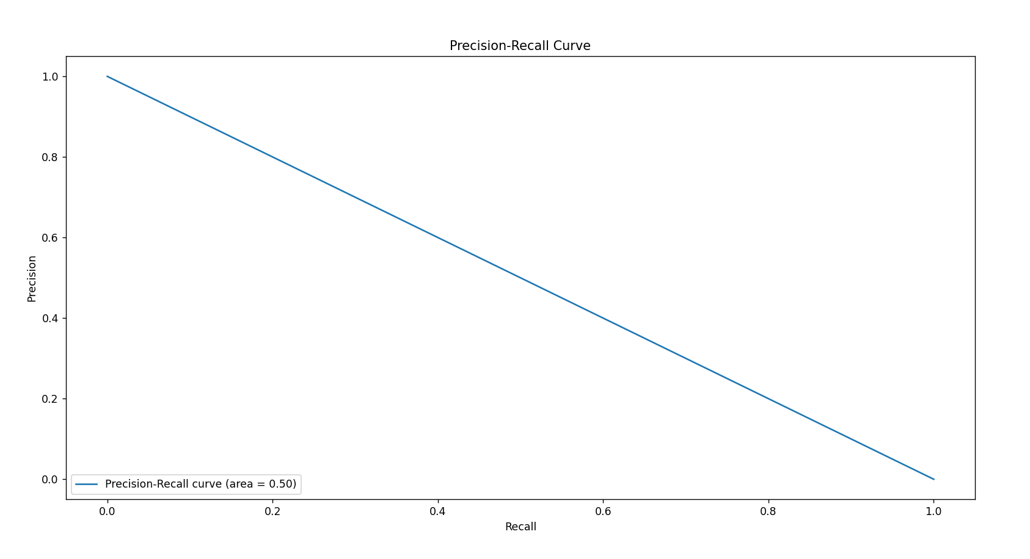

Result
To present the results of a machine learning model in terms of its accuracy and effectiveness in keyloggers and security implementation using Python, by follow the given steps.
Training the Model: Train your machine learning model using a dataset that includes features related to keystrokes (e.g., key pressed, timestamp) and a target variable indicating whether the keystroke is malicious or not.
Testing the Model: Test your trained model on a separate dataset to evaluate its performance.
Calculating Accuracy: Calculate the accuracy of your model by comparing the predicted labels with the actual labels in the test dataset.
Visualizing Results: Use visualizations such as confusion matrices, ROC curves, and precision-recall curves to highlight the model's performance.

Slide 8
Conclusion
The implementation of encryption in the keylogger enhances its security and protects the logged data from unauthorized access.
By using Python and its libraries, the development of the secure keylogger is made more accessible to users with varying levels of programming experience.

Slide 9
Future scope
Future enhancements could include adding features such as remote logging and encrypted communication between the keylogger and a central server.
Improvements in encryption techniques could further enhance the security of the keylogger, making it even more resistant to attacks.

Slide 10
References
Title: PyKeylogger: A Python-based Keylogger for Windows Authors: S. Karthikeyan and K. Kanimozhi Published in: International Journal of Advanced Research in Computer Science, 2019 .
Title: Development of Python Based Key Logger with Enhanced Security Authors: B. Vinod Kumar and N. Naveen Kumar Published in: International Journal of Pure and Applied Mathematics, 2018.
Title: Security Aspects of Keyloggers and Their Countermeasures Authors: S. K. Kavitha and P. Jayarekha Published in: International Journal of Engineering Research & Technology, 2013 .
Title: Design and Implementation of Python Based Key Logger with Cryptography Authors: P. S. Khilar and R. S. Rajesh Published in: International Journal of Scientific and Research Publications, 2015.
Title: Implementation of Secure Python Keylogger with AES Encryption Authors: M. K. Somasundaram and M. Balasubramanian Published in: International Journal of Computer Science and Mobile Computing, 2015.

Slide 11
THANK YOU

